Slide 1
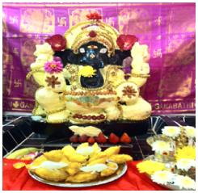
SRI LAKSHMI GANAPATHI TEMPLE
2764, Sawbury Blvd, Columbus, Ohio 43235
(614) 389 3413 / (614) 668 9884
Website: http://www.srilakshmiganeshtemple.org/
Temple Timings: Monday to Friday 9 AM to 11.30 AM
6 PM to 8.30 PM
Saturday & Sunday 9 AM to 1 PM
5 PM to 9 PM

Slide 4
*** New Year Day ***
Special Sarvadevatha Puja
Sarvadevatha Homam
Special Abhisekham and Alankaram for
Sri Lakshmi Ganapathi Swamy
TEMPLE IS LOOKING FOR PUJA AND FOOD SPONSORS

Slide 5
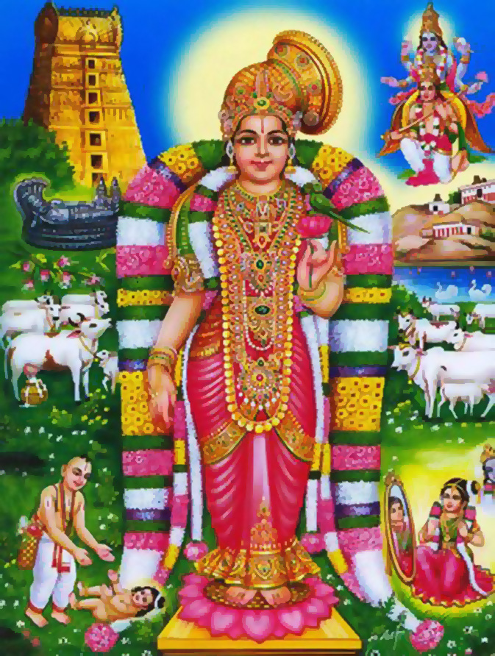
Godha Kalyanam - January 17th 2016, Sunday

Slide 6
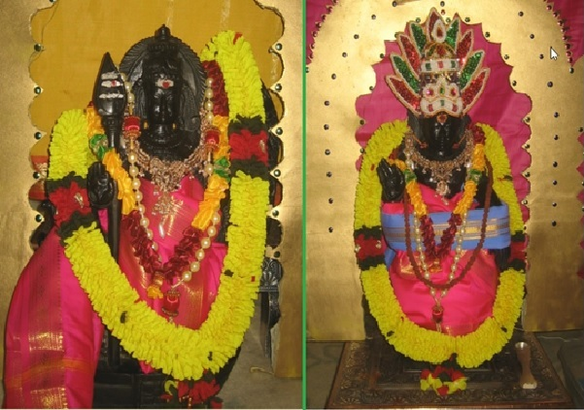
Lord Ayyappa Mandala Puja
When: Every Sunday
12/06/2015 - 01/14/2016(Makara Sankranthi).

Slide 7
NITYA SARVADEVATHA PUJA
DOLLAR A DAY ($365/yr)

Slide 8
Seva | Day
Sankata Hara Chaturthi Puja | 4th day after Full moon day
Venkateshwara Abhisekham | 1st saturday of the month
Lakshmi Abhisekham | 2nd friday of the month
Satyanarayana Puja | Full moon day
Pradoshams | Twice a month
Panchamukhi Anjaneya Puja with Aaku/Vadamala | Every Tuesday
Subramanya Swamy Abhisekham | 1st Tuesday of the month

Slide 9
Temple opens
ALL DAY

Slide 10
A
ABHISHEKAM $101
HOMAM $101
VAHANA PUJA $ 31
ARCHAN $11

Slide 11
SANKATA HARA CHATURTHI
PUJA $ 51
MAIN SPONSOR $101
FULL YEAR PUJA $ 501

Slide 12
SATYANARAYANA PUJA
PUJA $ 25
MAIN SPONSOR $ 51
FULL YEAR PUJA $ 156
PRIVATE T $ 101 - HOME151

Slide 13
PRADOSHAM PUJA
MAIN SPONSOR $ 51
FULL YEAR PUJA $ 501

Slide 14
SPECIAL EVENT
PRAMUKH YAJAMAN
YAJAMAN

Slide 15
VENKATESHWARA MONTHLY PUJA
PUJA $ 51
MAIN SPONSOR $101
FULL YEAR PUJA $ 501

Slide 16
LAKSHMI MONTHLY PUJA
PUJA $ 51
MAIN SPONSOR $101
FULL YEAR PUJA $ 501

Slide 17
MANDIRA BHOODANAM
LIFE TIME MEMBERSHIP $ 1001
PARKING SPACE EACH $ 2001

Slide 18
MANDIRA NIRMANA PROJECT
LIFE TIME MEMBERSHIP $ 1001
10X10 ONE SPOT $501
10 BRICKS $501
1 BRICK $101

Slide 19
Temple opens
ALL DAY JAN. 1ST

Slide 20
TEMPLE NEED VOLUNTEERS
CONTACT MANAGEMENT

